Slide 1

ADAPTING VBASBS QUEUEING MODEL FOR PROOF-OF-STAKE CONSENSUS ALGORITHM
Presented by Group 2:
Kyle Kentner Nathan Crosby Andrew Smith Sush Chittibabu Abdulla Karjikar
Notes:
Andrew

Slide 2

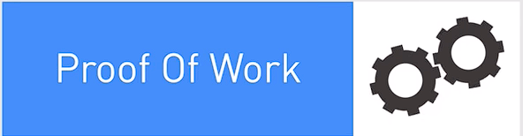

Introduction
Notes:
Andrew This work aims to establish a theoretical model to simulate how blockchain transactions are grouped, validated, processed, and purged from a network based on a proof-of-stake consensus algorithm.

Slide 3

Related Works
Performance optimization for blockchain-enabled distributed network function virtualization management
and orchestration
New Performance Model –
Notes:
Sush:

Slide 4
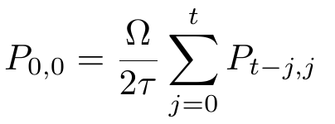

Methodology
Original Performance Model –
New Performance Model –
Notes:
Nathan:

Slide 5
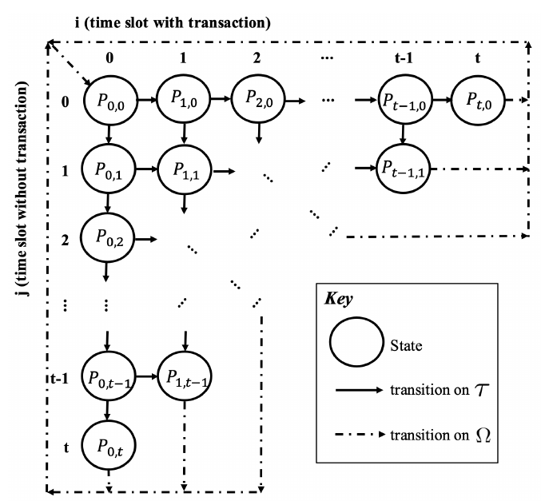
Methodology
Notes:
Nathan

Slide 6
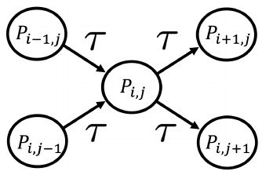
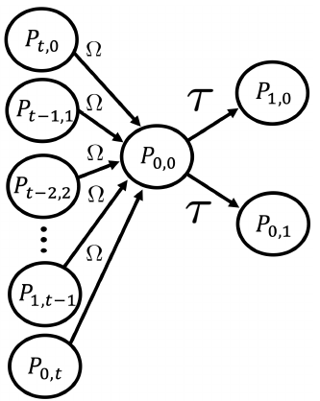
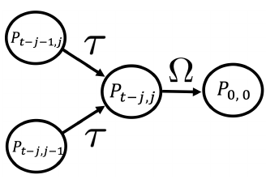
Methodology
Notes:
Kyle

Slide 7
Results
Python code generated plots available on github:
https://github.com/andrewqsmith/Block-Size-Optimization-for-VBASBS-Queueing-Model-for-Blockchain/tree/main/GraphCode
Notes:
Abdulla

Slide 8
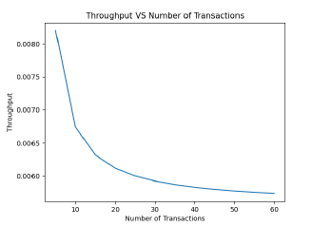
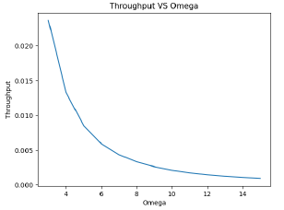
Results
Varying number of transaction time slices (t) in the network with constant block window time (T) and processing time (Omega) to examine changes in throughput
Varying time taken to post and purge the block in the network with constant block window time (T) and number of time slices (t) to examine changes in throughput
Notes:
Abdulla:

Slide 9
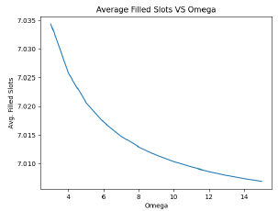
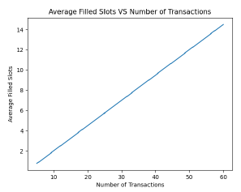
Results
Varying number of transaction time slices (t) in the network with constant block window time (T) and processing time (Omega) to examine changes in average filled slots
Varying time taken to post and purge the block in the network (Omega) with constant block window time (T) and number of time slices (t) to examine changes in average filled slots
Notes:
Abdulla

Slide 10

Conclusion
Notes:
Andrew

Slide 11
Questions?
Notes:
Team

